Slide 1
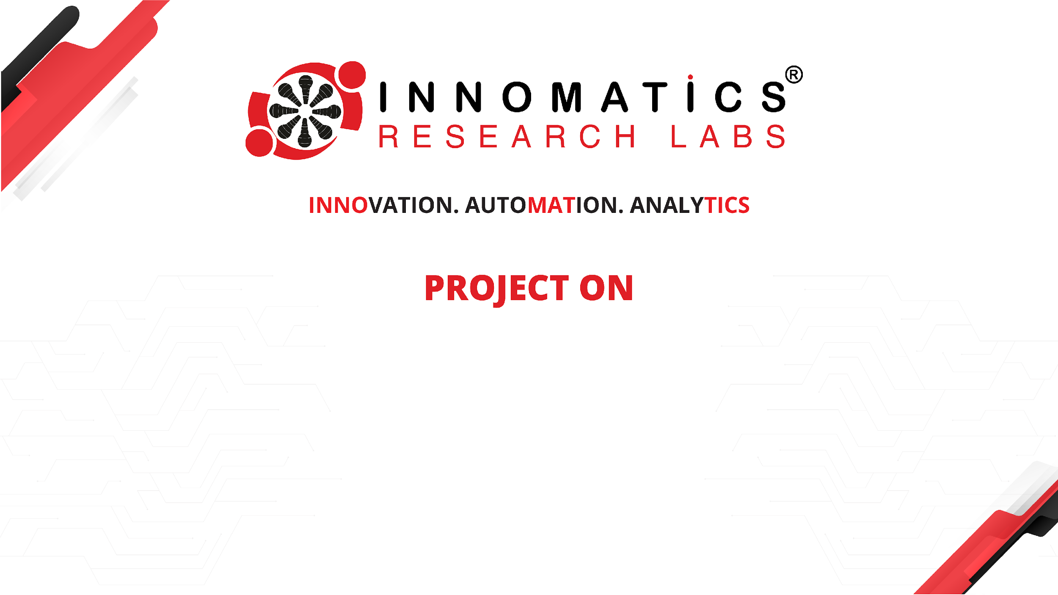
Exploratory Data Analysis (EDA) on Aspiring Mind Employment Outcome 2015 (AMEO) Dataset

Slide 2
About me
Hello, I'm Madhu Ganaveni, I have compled a Bachelor of Technology (B-Tech) degree in Civil Engineering at Jawaharlal Nehru University Hyderabad.
I want to learn data science because it's incredibly useful. It has a big impact on different industries and can help find important information in complicated data. Learning about data science is not just interesting, but it also gives me lots of chances to work in cool areas like artificial intelligence, machine learning, and predictive analytics.
While I haven't gained any professional work experience yet, I am eager to apply my theoretical knowledge in practical settings and contribute meaningfully to projects.
Below are my GitHub and LinkedIn profiles:
GitHub: github.com/Madhu733/Data-Analysis
LinkedIn: : linkedin.com/in/madhu-ganaveni

Slide 3
Agenda:
Business Problem and Use case domain understanding:
The AMEO dataset offers key insights into the employment outcomes of engineering graduates, benefiting stakeholders like educational institutions, recruiters, and policymakers. Understanding these trends aids in shaping recruitment strategies, skill development initiatives, and career counseling efforts for aspiring graduates.
Objective of the Project:
The objective of this project is to perform Exploratory Data Analysis (EDA) on the AMEO dataset to gain insights into the employment outcomes of engineering graduates. Through data visualization and analysis, we aim to understand salary distributions, job titles, job locations, skill assessments, and other relevant factors impacting the employment landscape.
Dataset:
https://docs.google.com/spreadsheets/d/1yKll2Vg_mRRrNP_yrUaGr53y1VZMygQo/edit#gid=1768379993

Slide 4
Business Problem and Use Case Domain Understanding:
The AMEO dataset offers key insights into the employment outcomes of engineering graduates, benefiting stakeholders like educational institutions, recruiters, and policymakers. Understanding these trends aids in shaping recruitment strategies, skill development initiatives, and career counseling efforts for aspiring graduates.
Objective of the Project:
The objective of this project is to perform Exploratory Data Analysis (EDA) on the AMEO dataset to gain insights into the employment outcomes of engineering graduates. Through data visualization and analysis, we aim to understand salary distributions, job titles, job locations, skill assessments, and other relevant factors impacting the employment landscape.
Summary of the Data:
The AMEO dataset contains 4000 rows and 40 columns, providing information on various aspects such as salary, job titles, job locations, and standardized skill scores. Initial exploration revealed the presence of duplicate values, missing data, and outliers, which necessitated data cleaning and preparation for analysis.
Exploratory Data Analysis:
Data Cleaning: Removed duplicates, handled missing data, and filtered irrelevant entries.
Data Manipulation: Prepared data for analysis through cleaning and transformation.
Univariate Analysis: Explored individual variables using histograms, box plots, and count plots.
Bivariate Analysis: Investigated relationships between variables through scatter plots, pair plots, and bar plots.

Slide 5
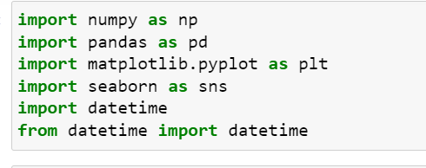
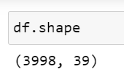
Exploratory Data Analysis:
Data manipulation:
Importing all the libraries which are necessary
Reading csv file and the shape of the file is as below:
The dataset consists of 3998 rows and 39 columns. Performed some data cleaning steps such as changing the datatypes and checking if the dataset consists of null values, duplicates, etc….

Slide 6
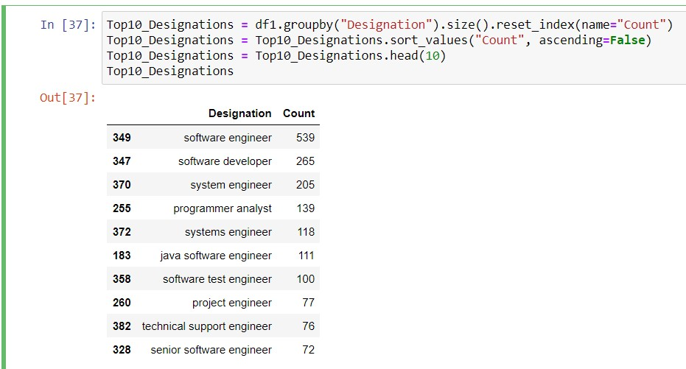
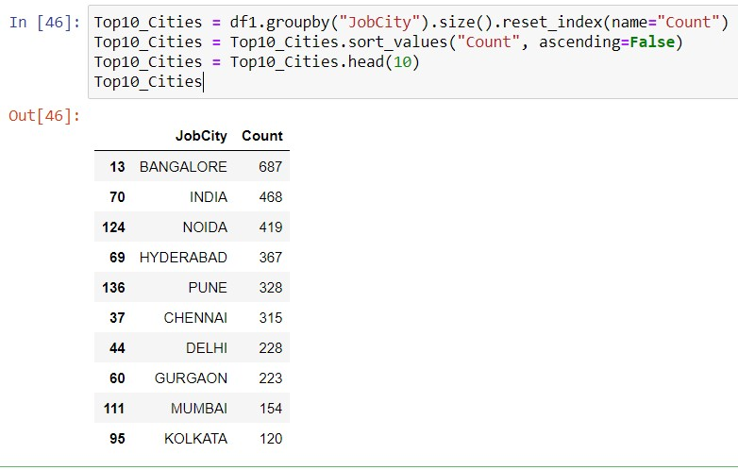
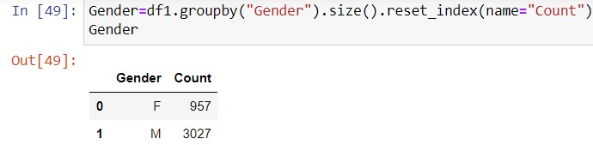
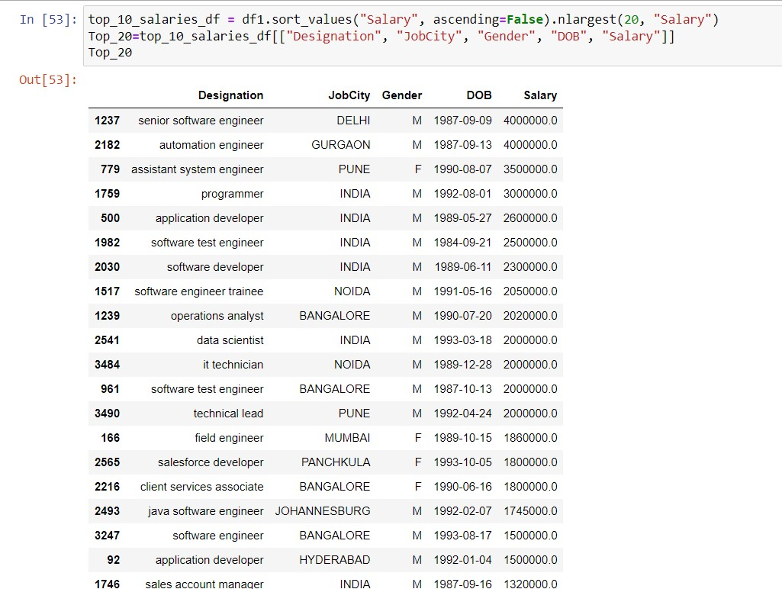
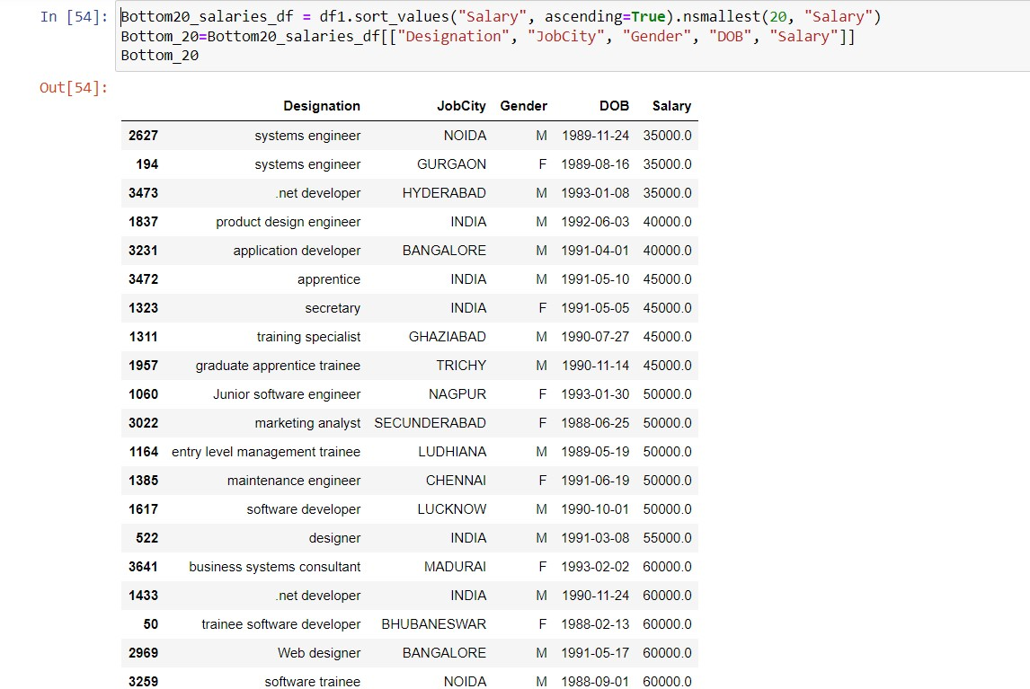

Slide 7
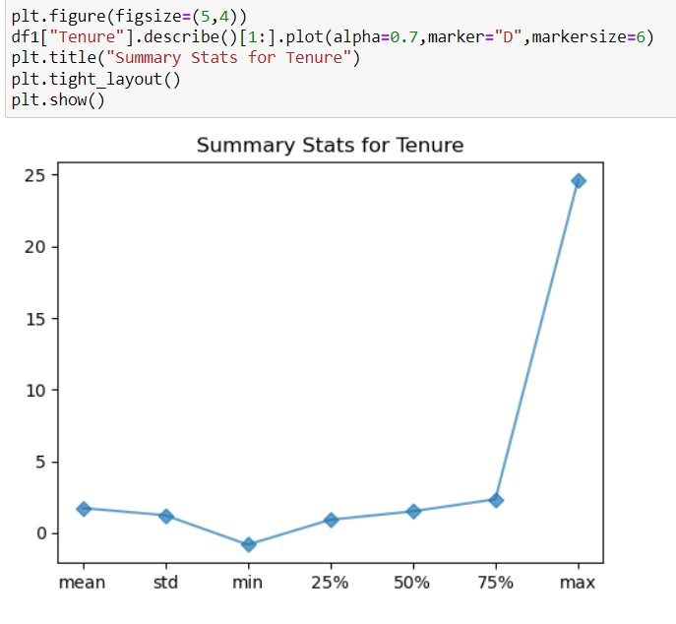
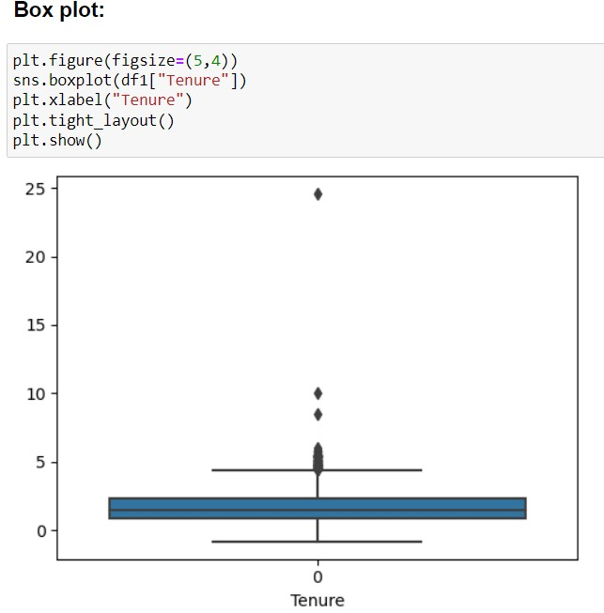

Slide 8
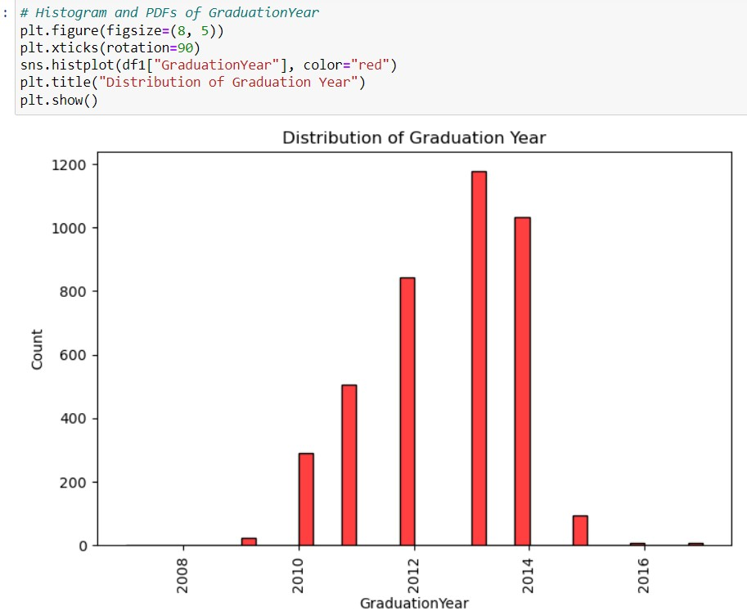
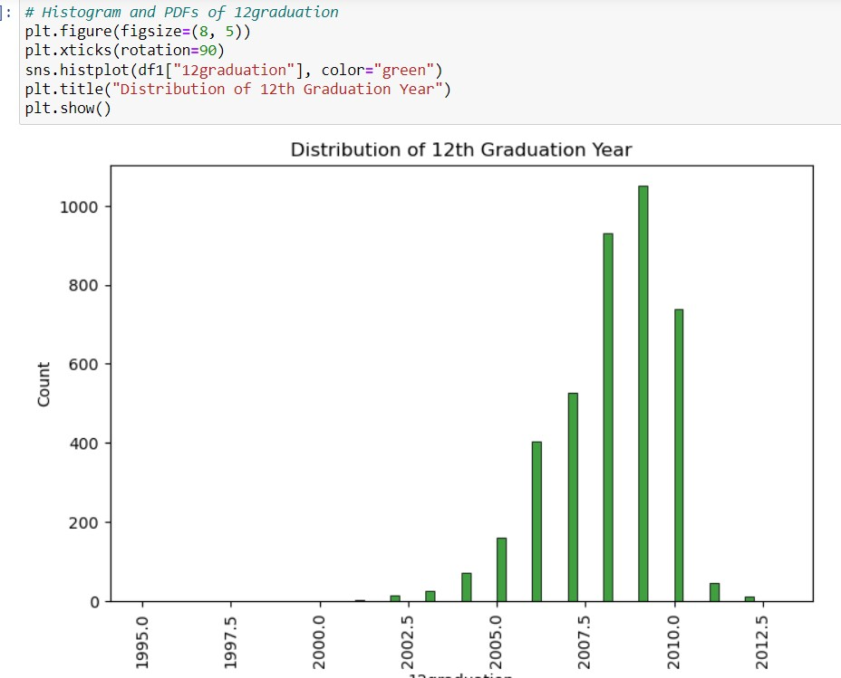

Slide 9
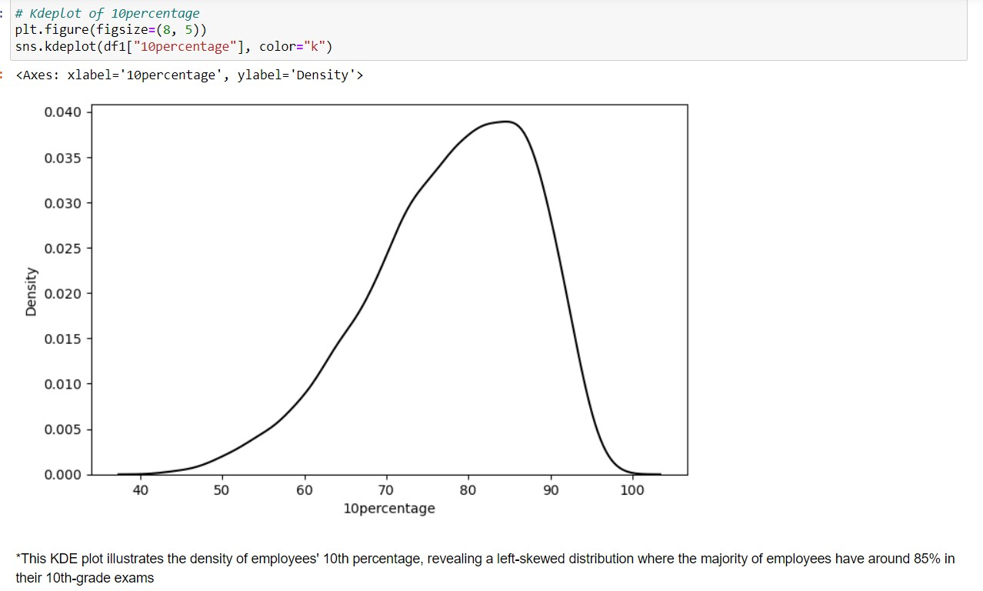
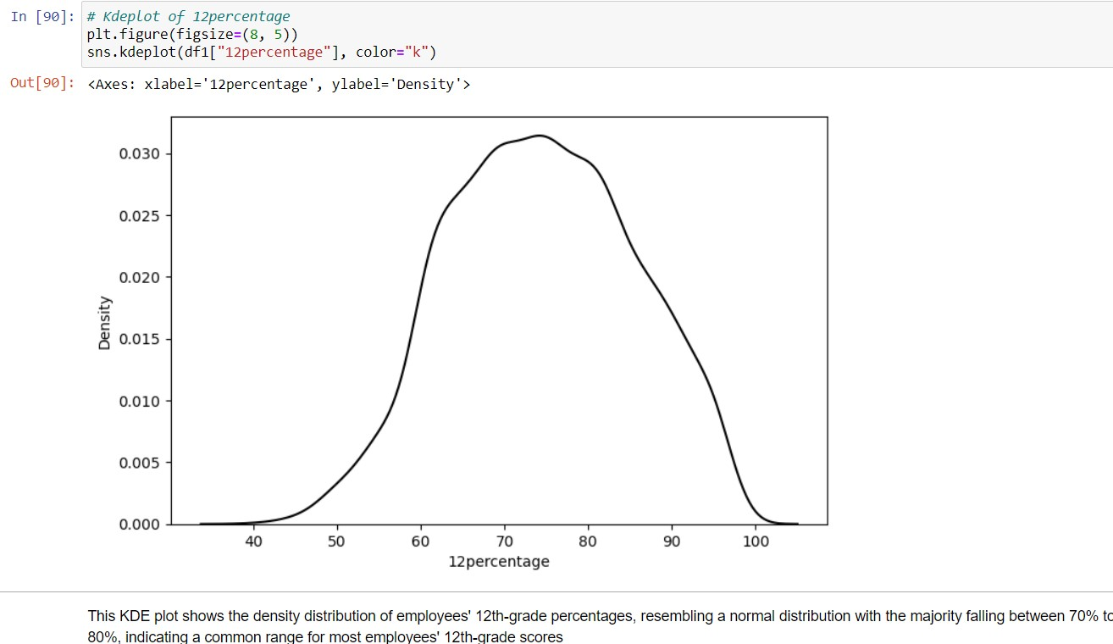

Slide 10
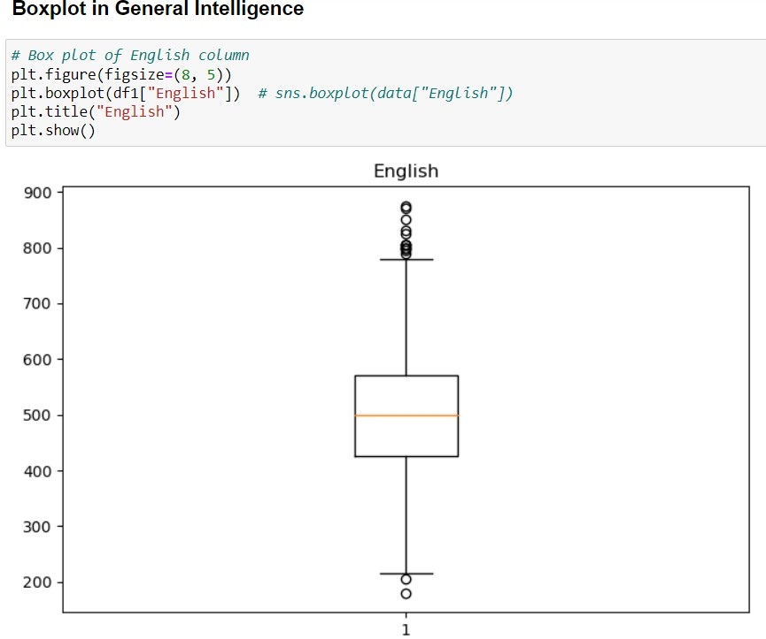
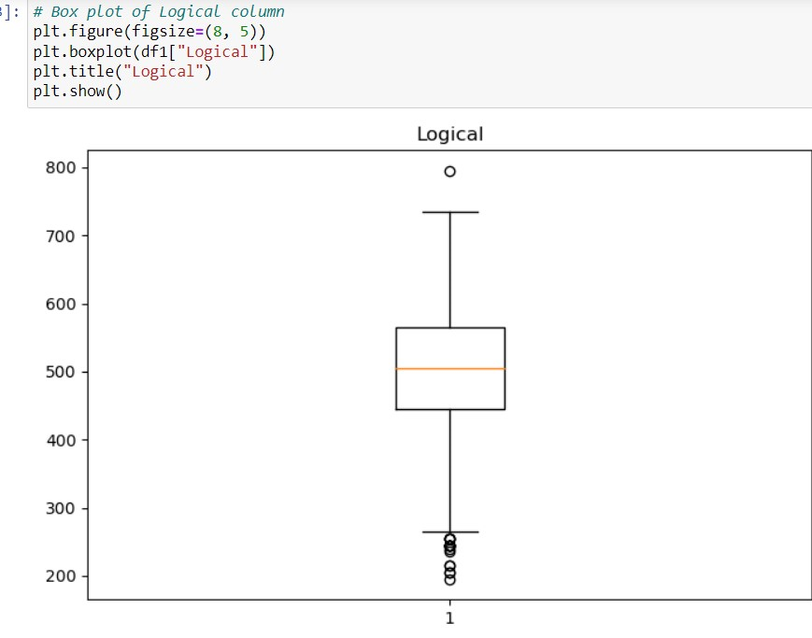
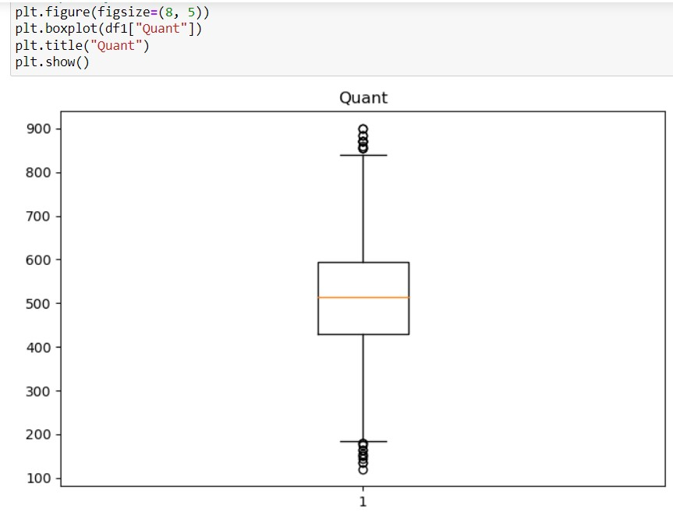

Slide 11
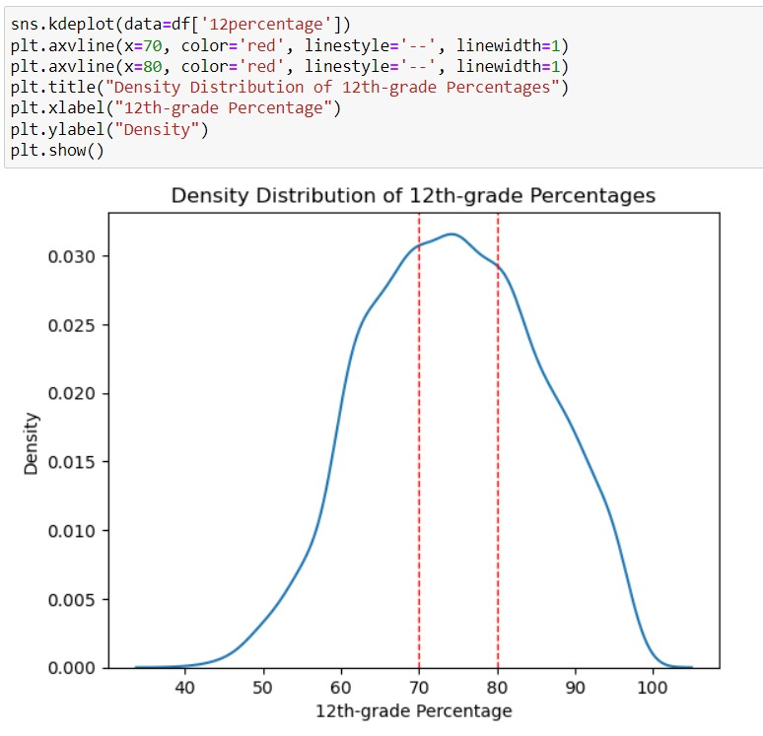
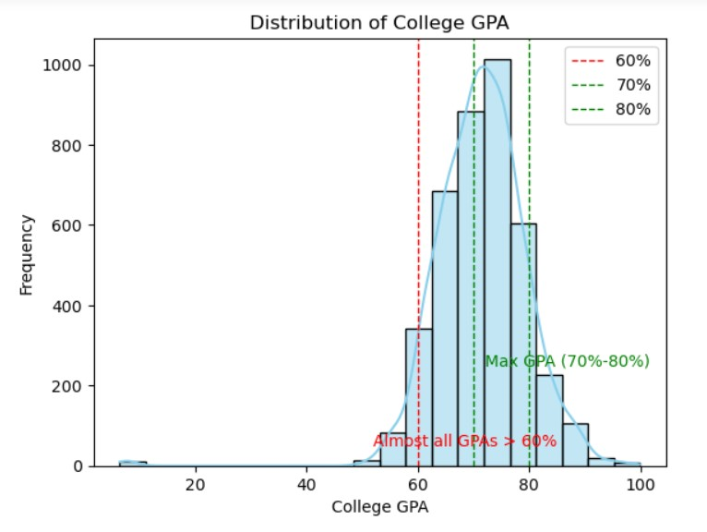

Slide 12
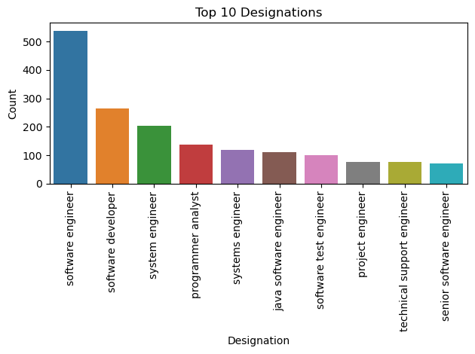
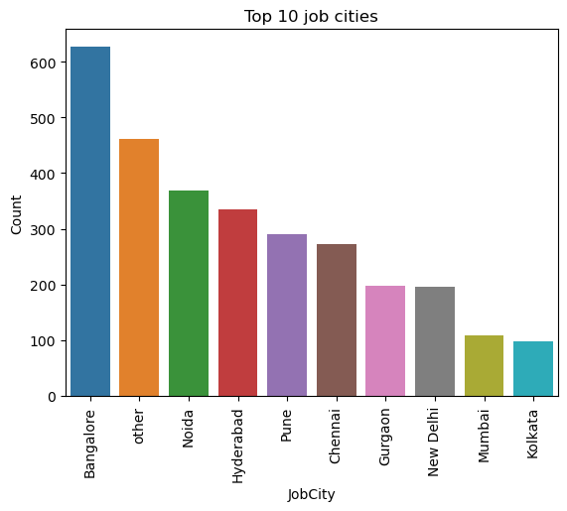

Slide 13
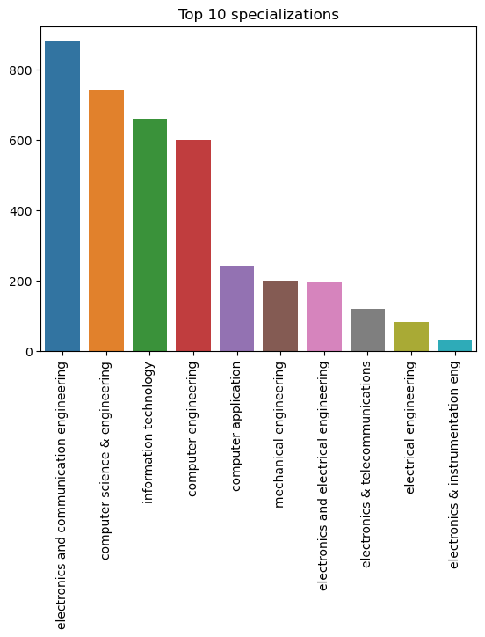

Slide 14
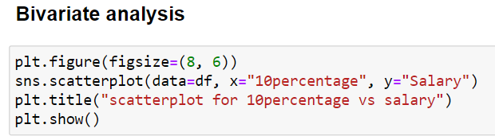

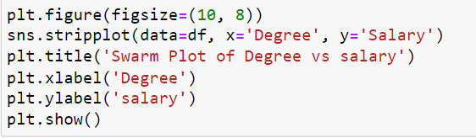
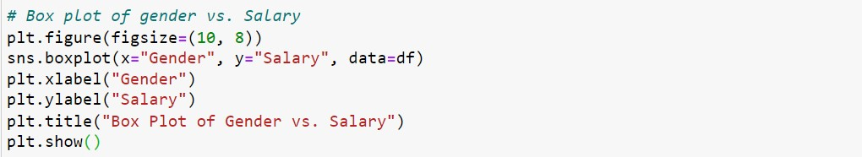

Slide 15
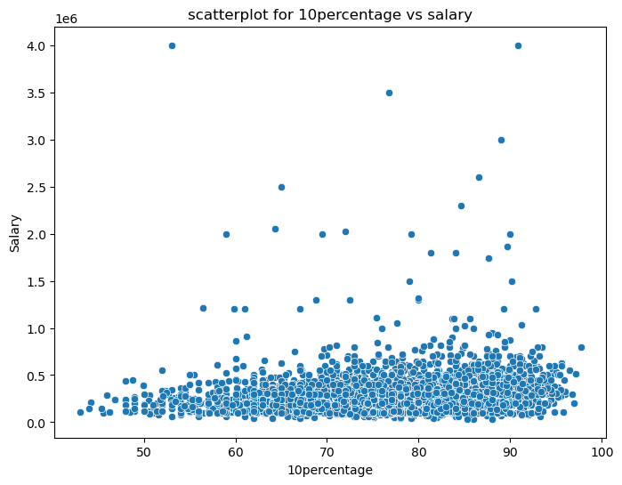
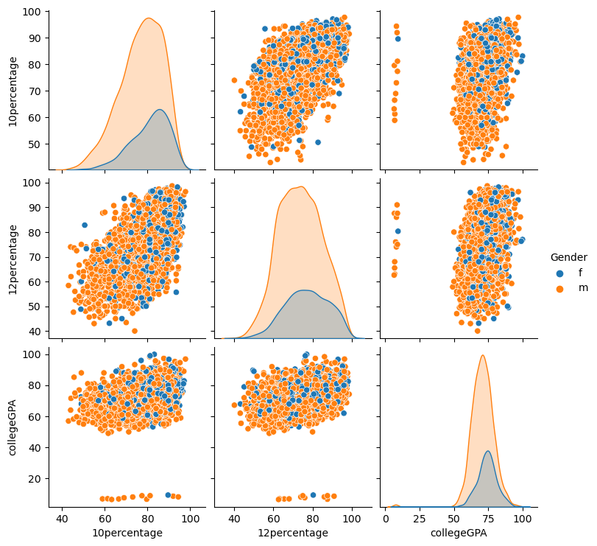

Slide 16
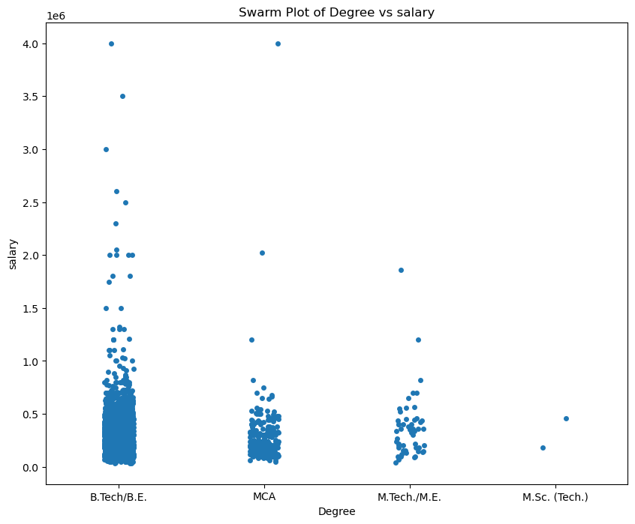
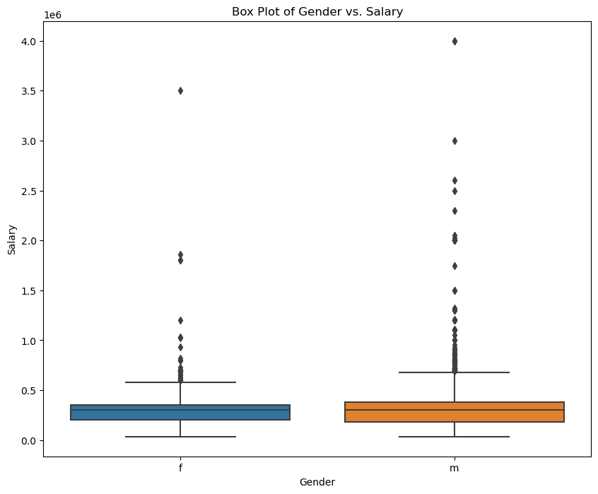

Slide 17
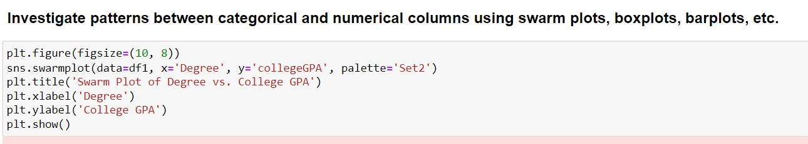
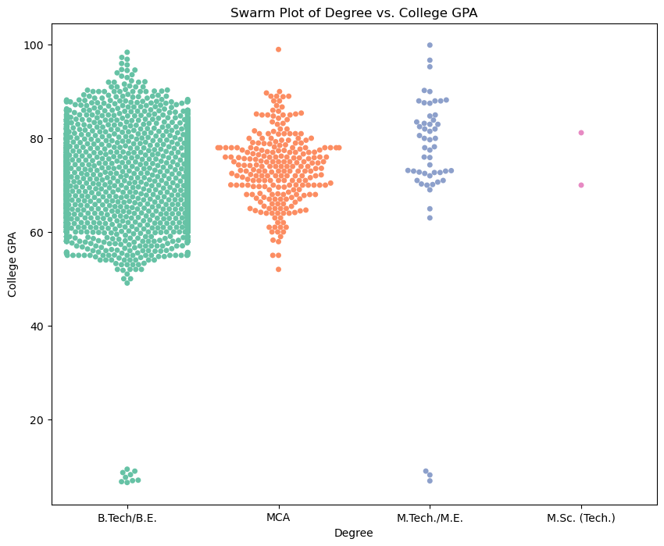

Slide 18
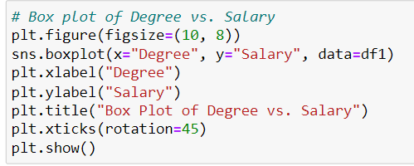
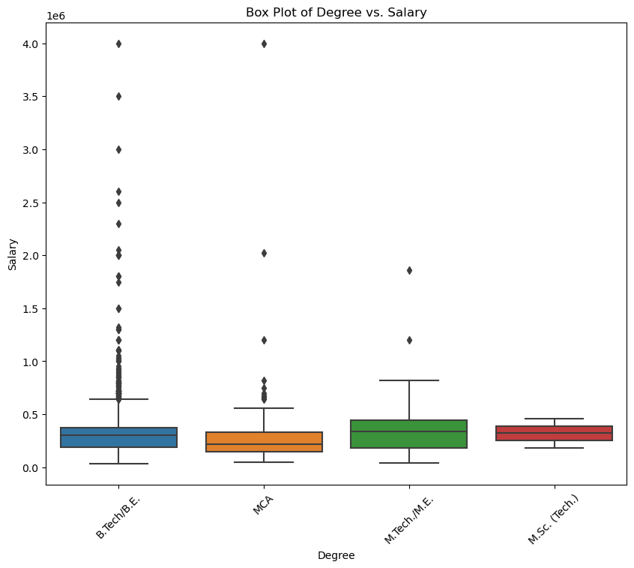

Slide 19
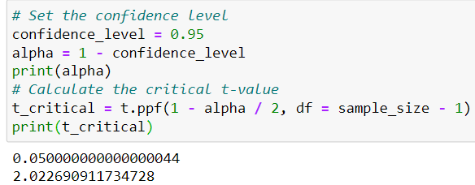
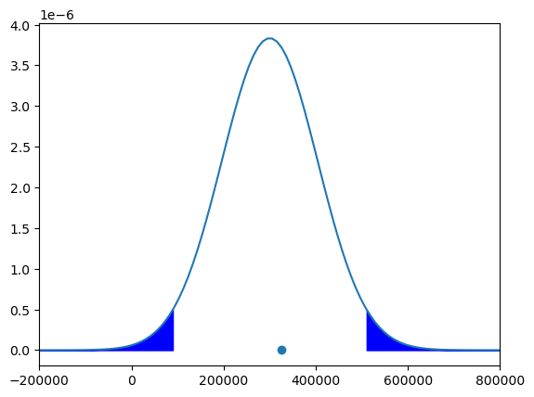
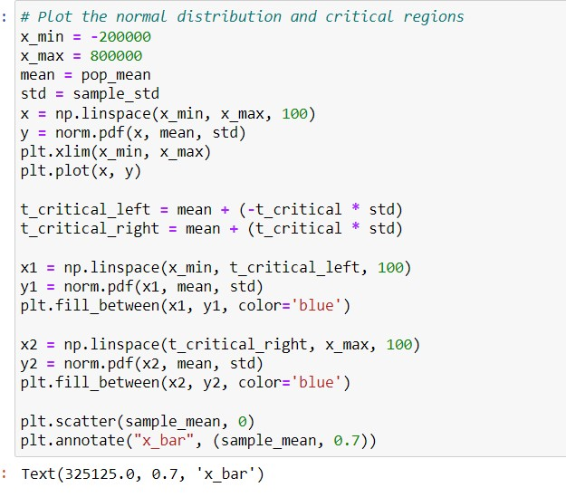

Slide 20
Key Business Question:
Can we substantiate the claim made by a colleague from a prestigious law firm regarding the recruitment criteria and average GPA of law graduates hired by the firm?
Conclusion:
Through rigorous data analysis and visualization, we gained valuable insights into the employment landscape for engineering graduates. Our findings highlight salary distributions, job titles, job locations, skill assessments, and other relevant factors influencing employment outcomes. These insights can inform stakeholders in recruitment strategies, skill development initiatives, and career counseling efforts. Additionally, we addressed a research question related to the recruitment criteria and average GPA of law graduates, providing statistical evidence to support or refute the claim made by a colleague from a prestigious law firm.
Q&A Slide:
This project showcases the power of Exploratory Data Analysis in uncovering insights from real-world datasets. We welcome any questions or discussions regarding the methodology, findings, or implications of our analysis.
Experience/Challenges working on AMCAT Data Analysis Project:
Throughout the project, we encountered challenges such as handling missing data, dealing with outliers, and ensuring the accuracy and reliability of the analysis. Despite these challenges, the project provided valuable learning experiences and insights into the employment outcomes of engineering graduates.

Slide 21

THANK
YOU

